Slide 1
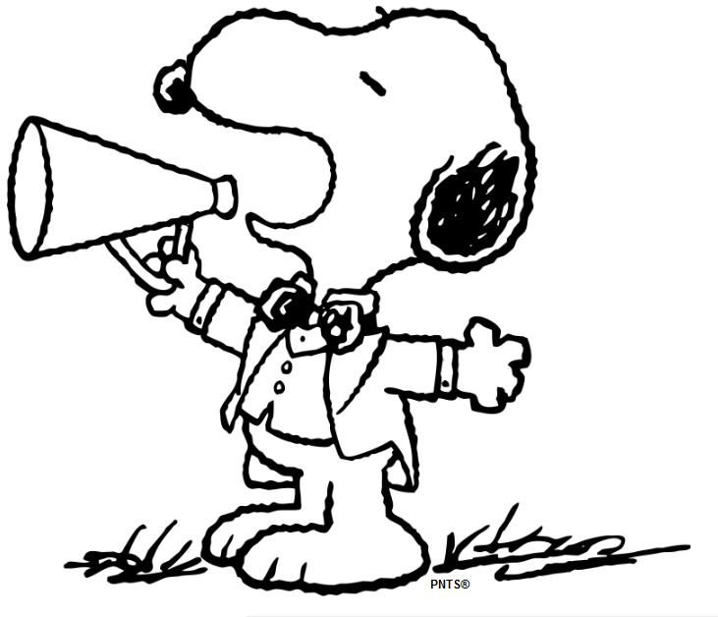
MRS.PEACOCK’S
WEEK OF: FEBRUARY 5-9, 2024
WE ARE LEARNING
Coming up @ NSE
Weekly Skills
WORDS TO KNOW
ELA: Poetry
PHONICS: OU, OW
MATH: Adding/Subtracting two 3- digit numbers
LANGUAGE: Adverbs
Social Studies: Famous Americans
2/8- Progress Reports
2/9- Valentine’s Party and $12 for music program due today
VOCABULARY
PHONICS Skill OF THE WEEK
**vocab test will be 2/9**
1.) Caption- it describes what is happening in the picture
2.) Image- a picture
3.) Similar- almost the same as something else
4.) Main Idea- what the passage is mostly about
5.) Glossary- it provides the meaning of key words
Spelling Words – OU, OW
bounce
snout
trout
mouth
pouch
hound
mount
sprout
clouds
read
live
count
shout
grouch
loud
ground
house
pretty
couch
mouse
IMPORTANT DATES
YEARBOOKS ARE ON SALE
THROUGH FEB. 29TH!
Reminders-
Please send a water bottle & snack daily!
Homework/Tests-
Homework- reading, math, and facts each night
Spelling & Vocab. test- Friday

